Slide 1

CCSESA Training
2016-17 Session 5
Notes:
Slide Time: 4 minutes Running Time + 4 minutes
Presenter Notes:

Slide 2
Plan for Today
Review the most recent updates from CDE
Explore navigating the California School Dashboard to build understanding and identify district performance indicators and the trends and patterns that exist
Engage in reflection of data with colleagues across regions via chat rooms to determine areas of strength, need and improvement to guide districts through an inquiry process of continuous improvement
Understand the role communication plays in creating coherent messaging
Review additional resources to support the LCAP continuous improvement cycle
Notes:
Slide Time: 6 minutes Running Time + 15 minutes
Presenter Notes:
Review Outcomes
provide the context at the outset that some of the time will be spent in reviewing the state tools/timelines/etc and some will be spent on models of processes and practices that are provided as an example that COEs might choose to replicate - so that we are clear the distinction between these two types of things.
We’ve also devoted time to share considerations about communicating this information to stakeholders at all levels; we’ve provided a number of resources that can be used for this purpose and will continue to enhance as additional materials are released from CDE.
Our intent of this webinar is to ensure that as county offices we are calibrated and deepening our expertise in supporting our LEAs with the process of continuous improvement. This webinar is a result of a collaborative partnership that continues to expand with state leadership as we work together in this new accountability rollout that guides LEAs in local decision-making to improve outcomes for each and every student.

Slide 3
California School Dashboard:
Navigating the System
http://cde.ca.gov/dashboard
CCSESA - December 2016
Notes:
Slide Time: Running Time +
Presenter Notes:

Slide 4
Understanding how the new local, state, and federal accountability system will provide a more complete picture of what contributes to a positive educational experience for students by reporting performance on multiple measures across the LCFF priorities.
Delving into how the Dashboard will assist LEAs in identifying strengths, weaknesses, and areas in need of improvement across all LCFF priorities.
Purpose
CCSESA - February 2017
Notes:
Slide Time: 30 seconds Running Time + 15 ½ minutes
Presenter Notes:
Education Code (EC) Section 52064.5 identifies three statutory purposes for the LCFF evaluation rubrics: to support LEAs in identifying strengths, weaknesses and areas for improvement; to assist in determining whether LEAs are eligible for technical assistance; and to assist the State Superintendent of Public Instruction in determining whether LEAs are eligible for more intensive state support/intervention.
EC 52064.5 (b) requires the evaluation rubrics tp reflect a holistic, multidimensional assessment of school district and individual schoolsite performance for each of the state priorities described in subdivision (d) of Section 52060.
The evaluation rubrics and the Web-based rubrics system, known now as the CA School Dashboard, or more commonly referred to as ”the Dashboard”, are key components in the emerging local, state, and federal accountability and continuous improvement system.

Slide 5
Updates - January - February 2017
January 11 – SBE approved “Distance from Met” as the Performance Standard methodology for the Academic Indicator
January 24 - School Dashboard Coordinator Designee letter (via email) to LEA Superintendents
January 31 - California School Dashboard Webinar series hosted by WestEd via WebEx
February 6 - Schedule released for In-depth Dashboard Webinar series provided by the CDE
February 10 - Preview credentials emailed to LEA Dashboard Coordinator
Notes:
Slide Time: 1 minute Running Time: 16 ½ minutes
Presenters Notes:
The Methodology used to determine “Distance from Met” was provided to the State Board of Education at their January meeting. The specific methodology for this, the Academic Indicator, is contained in Addendum 1 of Item 2 and can be accessed from the Resources folder
A copy of the Dashboard Coordinator Designee letter and thePreview Credentials email can be accessed by…..
In addition to the Overview for the PIOs, CDE is preparing a Technical Guide to assist stakeholders in navigating and understanding the Dashboard

Slide 6
Updates - February - March 2017
February 13 - CDE provides Public Information Officers with Media Toolkit. The week of February 13th- CDE adds data files and five-by-five Detailed Reports to LEA private preview.
February 22 - Webinar - English Learner Progress Indicator & Suspension Rate Indicator. Dashboard Embargo ends.
February 28 - Webinar - Graduation Rate & Career/College Indicator
March 6 - Webinar - Local Performance Indicators & Chronic Absenteeism
March – Public release of Dashboard
Notes:
Slide Time: 1 minute Running Time: 18 minutes
Presenter Notes:
The LEA embargoes preview window will extend through February 22 at 8:00 am. During the embargoes period, encourage LEAs to review the data for accuracy and report any problems with data or dashboard navigation to lcff@cde.ca.gov, so the CDE can address the issues prior to the public release.

Slide 7
Definitions
California School Dashboard - Web-based display reflecting performance data from the evaluation rubrics for LEAs and the public
LCFF Evaluation Rubrics - A new accountability tool required by LCFF that includes a set of state and local indicators to assist districts in identifying areas in need of additional support.
Indicator - Provides evidence whether certain results have or have not been achieved.
State Indicators are those where the data is loaded into the dashboard by CDE
Local Indicators are those where the determination is uploaded to the dashboard by the district.
Notes:
Slide Time: 2 minutes Running Time: 20 minutes
Presenter Notes:
We wanted to clarify the language of a few different terms that are used frequently with the new accountability system
California Dashboard
LCFF Evaluation Rubrics
Indicator
Whether students are graduating is the indicator; graduation rate is the metric. (SBE example)

Slide 8
Performance Standards set for all LCFF Priorities
LCFF Priority | State Indicator | Local Indicator
Priority 1 |  | Basics Conditions at School
Priority 2 |  | Implementation of State Academic Standards
Priority 3 |  | Parent Engagement
Priority 4 | Academic Indicator English Learner Progress Indicator
Priority 5 | Chronic Absence Indicator Graduation Rate Indicator*
Priority 6 | Suspension Rate Indicator | Local Climate Survey
Priority 7 | College/Career Indicator*
Priority 8 | College/Career Indicator*
Priority 9 |  | Coordination of Services for Expelled Students**
Priority 10 |  | Coordination of Services for Foster Youth**
*High School Only **COE Only
Notes:
Slide Time: 1 minute Running Time: 21 minutes
Presenter Notes:
The LCFF statute required there to be a standard set for each State Priority. Performance Standards have been set for all State Priorities, some by way of a State Indicator and some will be included as a locally evaluated measure, referred to as Local Indicators.
The State Indicators will be populated using data collected through CALPADS
The Local Indicators must be populated by the LEA
For 2016-17, the College & Career Indicator will be considered a “Local Indicator”

Slide 9
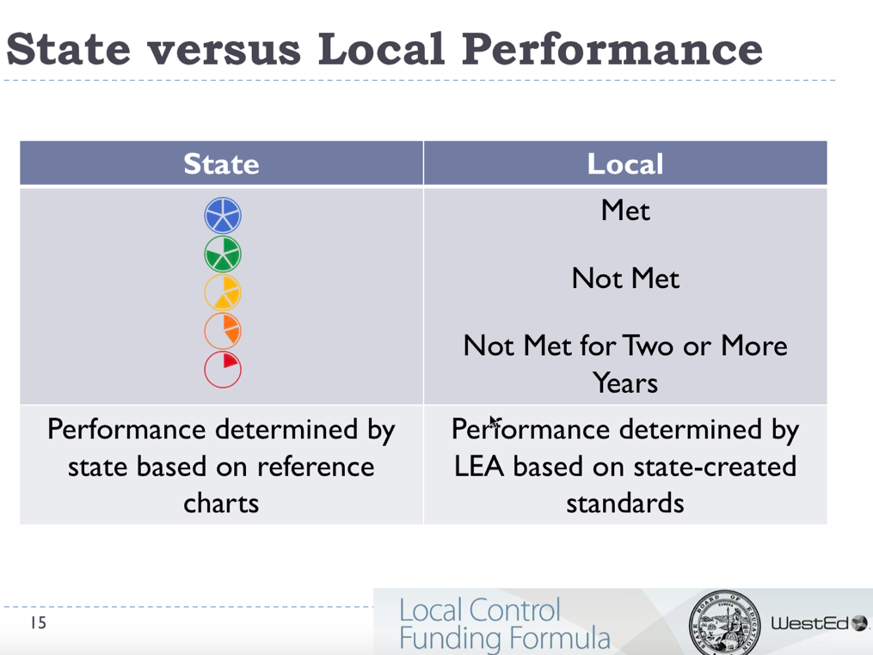
Performance Levels
State Indicators
High
Local Indicators
Low
Notes:
Slide Time: 30 seconds Running Time: 21 ½ minutes
Slide(s) Intent: Familiarize participants with the color schema used to display Performance Standards for State Indicators and the 3 levels for Local Indicators
Presenter says:
For each of the State Indicators, data results are reflected as a color on a circle graphic shaded to reflect the degree to which the LEA or School is progressing
The range of color is from Blue at the highest range on the continuum to Red representing the lowest range - Red and Orange and Yellow - indicate a need for further investigation, attention and action to Green and Blue indicating the school/district is on a track that supports continuous improvement.
For the Local Indicators, results can be determined to have “Met” the standard, or “Not Met” it. After next year the option of “Not Met For Two or More Years” will also exist.
The area shaded for each circle provides a additional representation of the Performance Level and allows for understanding even if the color is not discernable.
COEs should expect to see LCAP Actions/Services addressing the LEAs Performance Levels

Slide 10
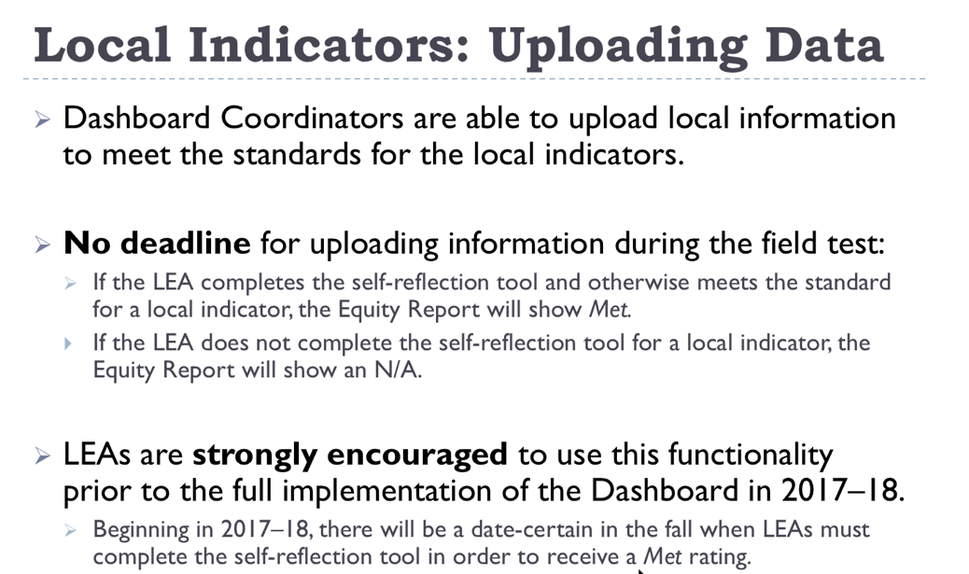
Notes:
Slide Time: 1 minute Running Time: 22 ½ minutes
Presenter Notes:
The information and Results (Met, Not Met, Not Met for 2 Years) for all Local Indicators must be uploaded by the LEA Dashboard Coordinator.
For the initial release, (February 2017 for the 2016-17 school year) Local Indicators will display “Met” if the LEA enters the information into the data fields.
CDE anticipates a November 2017 release for the 2017-18 Dashboard. For the 2017-18 release, LEAs MUST complete the required upload of information for all Local Indicators within the prescribed time period or the LEA will be assigned a NOT MET rating.

Slide 11
Embargo
The LEA private preview window extends through Wednesday, February 22, 2017 at 8:00 am
You cannot share any of the Dashboard reports or data in the Dashboard outside employees of your LEA during the embargo period
All LEA employees who receive Dashboard reports or data during the preview period must understand and agree to honor the embargo
Notes:
Slide Time: 30 seconds Running Time: 23 minutes
Presenter Notes:
Districts are to report right away to CDE any problems with the data or the links
The private preview is intended to allow you and your colleagues to become familiar with the Dashboard and the indicators and methodology for measuring performance.
The embargo ends prior to the Dashboard’s public launch in March 2017. LEAs may begin sharing their performance data with local stakeholders at that time, and it is up to each LEA to determine whether to do so and, if so, how.

Slide 12
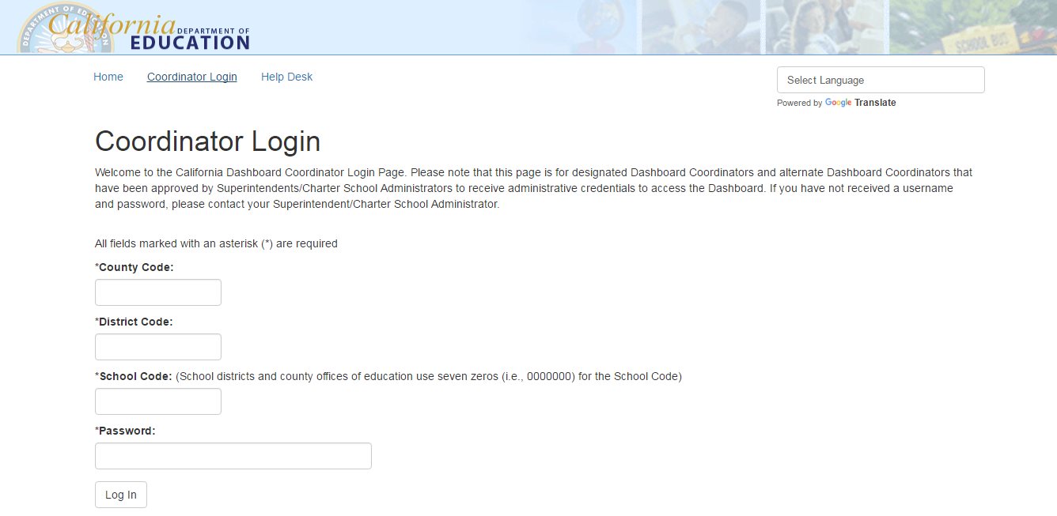
Navigating the CA School Dashboard
Coordinator Login Page: https://www.caschooldashboard.org/#/coordinator
Notes:
Slide Time: 10 minutes (for launch and live display of Dashboard reports) Running Time: 33 minutes
Presenter Notes:
Navigate to https://www.caschooldashboard.org/#/coordinator To locate the password protected CA School Data Dashboard launch page

Slide 13
Numerically Significant Student Groups
Less than 30 students
No performance level reported for any indicator with fewer than 30 students
Status and change displayed for student groups with 11 to 29 students
Reported as an asterisk (*) for all students and student groups
No Available Data
Where data is currently not available, it is reported as not applicable (N/A)
Implications for small schools and charters:
Focus on the “All Students” group as these results will be the most statistically accurate
May not have enough students to generate student subgroup displays/reports
The smaller the student group, the greater volatility to Indicator results based upon individual student performance
Notes:
Slide Time: 2 minutes Running Time: 35 minutes
Presenter Notes:
For a student group to be considered “numerically significant” there needs to be 30 or more students...
Less than 30 students
No performance level reported for any indicator with fewer than 30 students
Status and change displayed for student groups with 11 to 29 students.
Reported as an asterisk (*) for all students and student groups.
No Available Data
Where data is currently not available, it is reported as not applicable (N/A).
For ex – small schools will want to look at displays for “all students” foremost, because these will be the most statistically accurate. Small schools may not have enough students to have many sub-group displays and even if they do, then changes in a couple scores can make a much bigger difference in the “color” they earn.
For elementary and high schools we may need to adapt depending on how the dashboard looks – are the nonapplicable indicators there?

Slide 14
Navigating the CA School Dashboard
Timeline to Support LEAs and Schools
2016-17
COE support for LEAs and schools
CCEE upon request
2017-18
COEs (or the SPI/CDE) provide differentiated assistance to LEAs [EDC 52071; EDC 47607.3]
CCEE upon request
2018-19
COEs provide differentiated assistance to LEAs and schools
CCEE intensive intervention to LEAs and schools [EDC 52072]
Notes:
Slide Time: 1 minute Running Time: 36 minutes
Presenter Notes:
Here is the tentative timeline for support for LEAs and schools.
In 2016-17:
COEs are supporting LEAs throughout the LCAP development process and by provide PD opportunities that support LEA initiatives like classroom walk-throughs and coaching.
The CCEE is providing training sessions across the state and has identified a number of “Early Adopter Professional Learning Networks.” The CCEE committed to provide annual workshops, collaborative trainings and establishing an “Advice Line” in collaboration with the CDE and CCSESA.
For 2017-18:
Under current SBE actions, TA for districts will start in Fall 2017. The timing for TA for schools is still uncertain but most likely will start in 2018-19.
Ed Code sections 52071 and 47607.3 outline the responsibilities of COE/SPI/CDE to provide differentiated support to LEAs, including Charter Schools.
For Districts: COEs may assign a team - or a partner district - to assist in identifying and implementing effective programs to improve pupil outcomes if the Dashboard data indicates the LEA has not improved pupil achievement across more than one state priority; or has not improved pupil achievement across one or more subgroups.
For Charters: The Chartering Authority provides TA to their schools that fail to show improvement for three or more pupil groups - or all of the charter school’s pupil groups if the school has fewer than three subgroups. The State Superintendent can assign the CCEE to support the Charter School if the Chartering Authority requests assistance.
The CCEE is available to provide advice and assistance to LEAs at the request of the COE.
For 2018-19
COEs continue to provide differentiated assistance as described above
The CCEE, at the request of the State Superintendent and SBE, will provide TA to school districts if three or more pupil groups do not show improvement in more than one state priority for three out of four consecutive years. If the district has less than three pupil groups, this criteria applies to all of the school’s pupil groups.
CCEE supported Intensive Intervention may include a budget revision to better align expenditures to student needs as identified on the Dashboard; OR stay or rescind a local collective bargaining agreement that prevents the district from improving outcomes; OR appoint an academic trustee.

Slide 15
Modeled Experience:
Changing Our Mindset
Facilitated Reflection of Indicators
CCSESA - February 2017
Notes:
Slide Time: 10 seconds Running Time + 36 ½ minutes
Presenter Notes:
https://docs.google.com/document/d/10FEmRZO8N4SGMokbAdXk1tBupwOsb1XEzubn3JvalWA/edit#
Modeled think aloud of dashboard scenario with facilitated discussion about how to guide districts in a reflective process towards continuous improvement

Slide 16
Using the interactive dashboard, engage in data reflection to determine areas of strength, need and improvement to guide districts through an inquiry process of continuous improvement
Develop awareness of an Improvement Process that supports LEAs in targeting areas of focus that will inform their LCAP goals, actions and services in promoting improved outcomes for students
Purpose
CCSESA - February 2017
Notes:
Slide Time: 30 sec Running Time + 37 minutes
Presenter Notes:
Overview of the key purposes of this section.
In designing a multi-layered communication plan, it will be important to consider the various audiences (stakeholders) and what information may be most useful to them. In this section, we provide some guiding questions to help leaders throughout the system think through their approach.

Slide 17

How do we help Districts improve through a
Continuous Improvement Process?
Notes:
Slide Time: 1 min Running Time + 38 minutes
Presenter Notes:
TRANSITION: frame as a potential COE approach and is offered as a model and example. Shifting from the statutory requirements into this potential approach a COE might employ in supporting LEAs in using the data through an improvement mindset..
Set rationale for disciplined inquiry as part of continuous improvement process.
What we know is that Dashboard and LCAP are now key drivers in a continuous improvement process
We know that a mindset of continuous improvement requires a shift from how districts might have responded in our last system (API/AYP)
Heavy lifting in helping LEAs take on an inquiry stance ----how can we support districts with processes so that they learn to build knowledge that leads to improvement. How can help them learn? An inquiry based approach can be helpful in doing this.

Slide 18
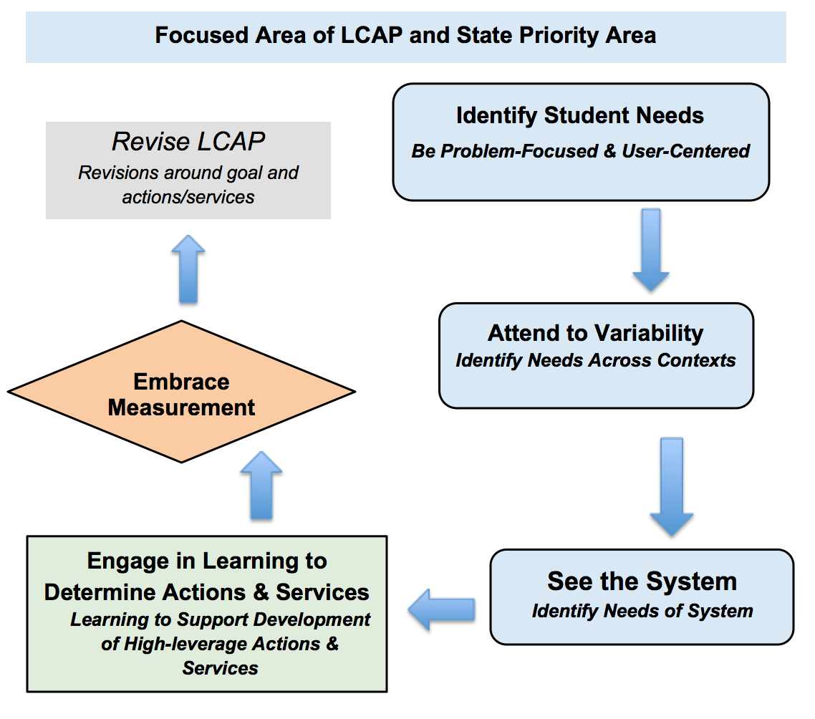
Big Picture:
Thinking through an Improvement Process
Notes:
Slide Time: 2 min Running Time + 40 minutes
Presenter Notes:
Review: Potential improvement process that we visited in first CCSESA training, based upon the elements of Improvement Science.
Regrounding: Assist districts in shifting to a continuous improvement approach for multiyear LCAP planning, including disciplined inquiry that will inform plan development for improvement over time, with focused acceleration for students.
Requires that organization takes a learning stance---to deeply understand why they are getting the current results. The way that we do this is by learning to uncover/unearth student needs by paying attention to variation and seek to understand how the system contributes to the strengths/needs/challenges. One of the big ideas here is that when the organization takes a learning stance, it is focused on understanding well the problem to inform their strategic use of actions/services for targeted improvement efforts.
Clarify variation: What works for whom and under what conditions.
Final Thought: Improvement approach----means that we are learning to build knowledge that leads to improvement. An inquiry process helps us to learn to inform our LCAP to target improvement

Slide 19

“If I had 1 hour to save the world, I would spend 55 minutes defining the problem and 5 minutes solving it.”
Einstein
Notes:
Slide Time: 1 min 30sec Running Time + 41 ½ minutes
Presenter Notes:
The take away from Einstein-- help LEAs take on a learning stance to learn deeply from their needs shown in the data
This requires a shift, as typically we have a tendency to respond and react to the data, and want to get to the solution. We call this a culture of solutionitis, and we find it throughout education.
As we support LEAs with making meaning of the Dashboard--We want to help them avoid solutionitis (e.g., just reacting to the colors) and work to get grounded in deep understanding of the problem that they are curious about.
Deeper dive to understand why we are getting the current results that we are getting for this group of students.

Slide 20
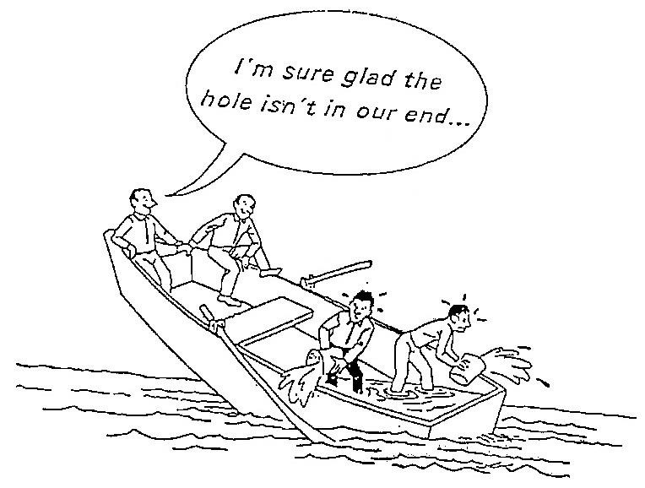
Changing Mindset
Notes:
Slide Time: 30 seconds Running Time + 42 minutes
Presenter Notes:
Example of how sometimes we have approached improvement- not as a system approach with continuous improvement mindset. We tend to look at data, identify the hole where the water is leaking through, then commonly address problem in isolation
Teaching point: we are helping LEAs to study deeply and investigate from a system point of view so that they are not reacting to problems in isolation but understanding that the results are baked into the system.

Slide 21
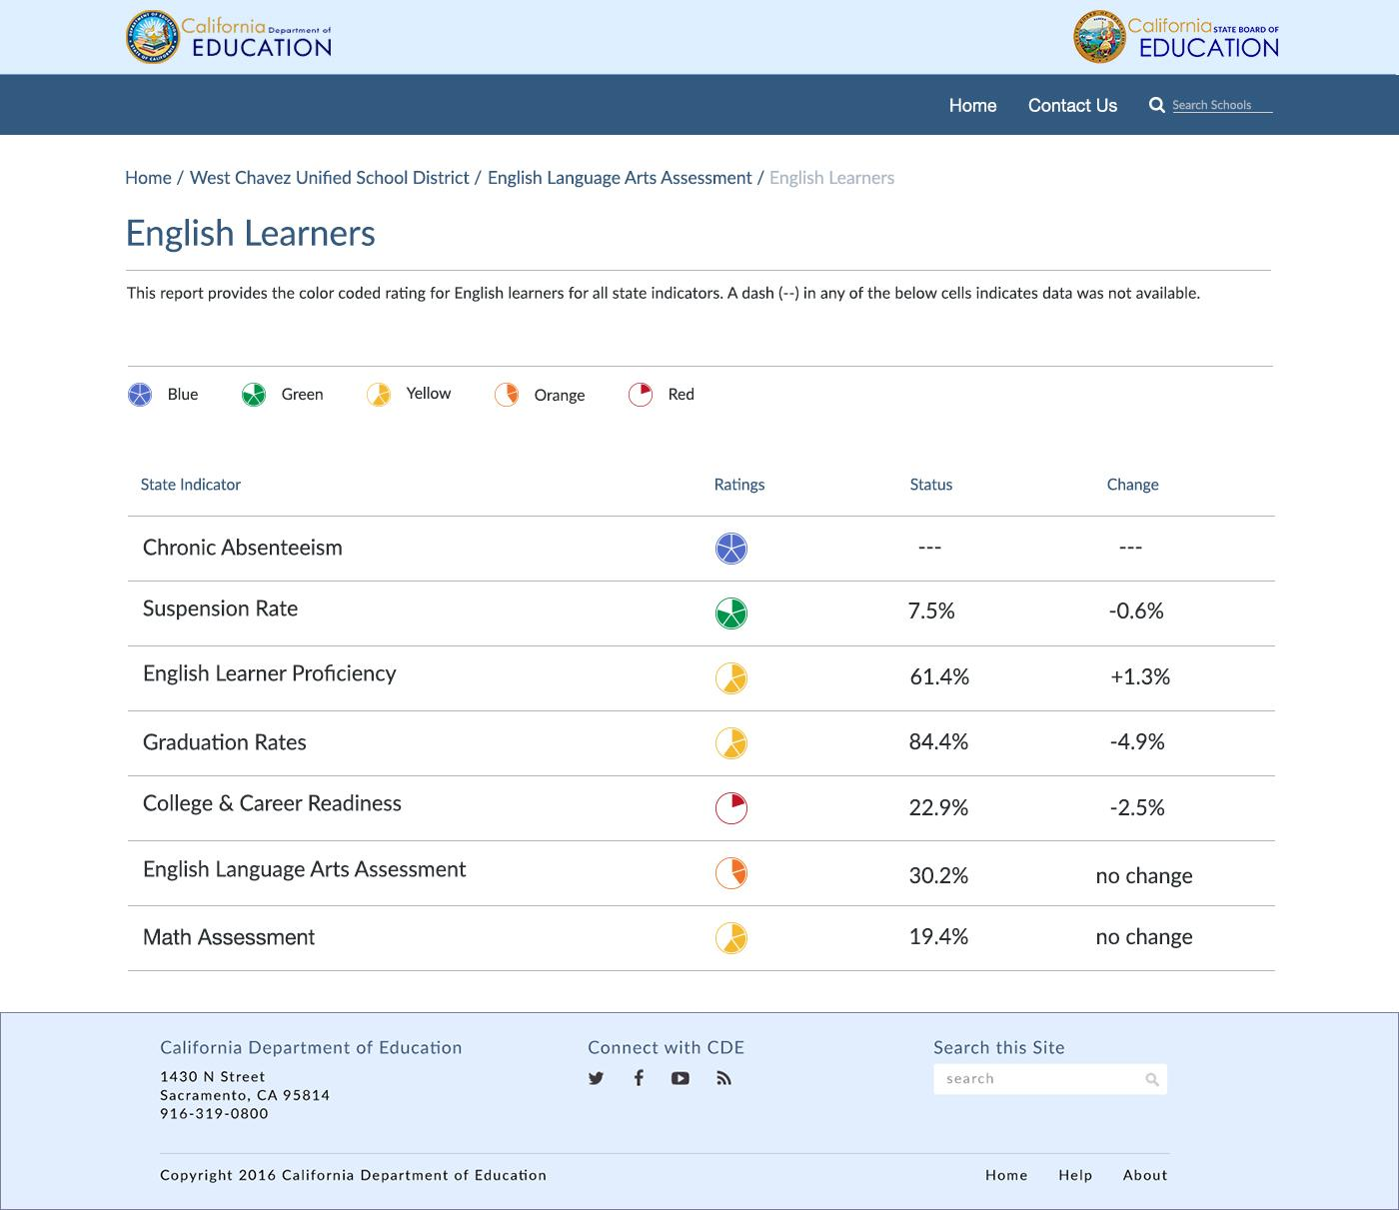
Changing Mindset-Moving to Curiousness
LCFF Accountability Dashboard
Initial Noticings
Build understanding of data around performance standards
Identify strengths, needs, & equity gaps
Determine areas of curiousness
Reflection Question:
From the LEA data we saw earlier- What might be an area we need to be more curious about?
Focused Learning Investigation
Deeper dive to understand why we are getting the current results for this group of students.
Notes:
Slide Time: 4 min Running Time + 46 minutes
Presenter Notes:
This is A GOOD TIME TO SAY THAT THE DASHBOARD IS THE BEGINNING OF THE CONVERSATION. MANY FOLKS HAVE THE FRAME OF "I NEED TO WRITE THIS LCAP." WE NEED TO ENCOURAGE THEM TO IDENTIFY WHAT THE DEEPER DIVE IS BEYOND THE DASHBOARD.
Take a look at how we might think through an improvement approach to Learn
Dashboard informs our initial noticings----we will see areas where positive change is occurring and we will notice areas of disparity
Support shift in mindsets of how people use data. An improvement approach requires us to be curious.
If equity is at the core, what areas are ripe for improvement and what would we want to take a deeper dive to understand why we are getting the current results.
Continuous improvement mindset----looking at data from a variety of sources.
Reflection question----2 minute with think aloud example
We are going to provide an example of what a Focused Learning Investigation might look like.

Slide 22
Key Principles of Data Investigations for Improvement
Data visualization
Reacting to data
Explore variation
Deeper learning questions
See data in a form that you can learn from
Use data for improvement
Look at the data in ways that will highlight variation
Ask the right questions to inform additional data gathering
Notes:
Slide Time: 2 min Running Time + 48 minutes
Presenter Notes:
Build off idea from the previous slide-----we want to support LEAs through processes that promote learning that build knowledge that leads to improvement.
How can we use data through an improvment lens to foster learning in the organization?
We want to keep these principles in mind as we help LEAs with processes to LEARN from their data to inform their thinking for improvement,
Data visualizations. A big piece of using data from an improvement perspective is being able to see the data in a form that you can learn from.
Reactions to data:
A focus on improvement. This is going to feel a lot different and push against current cultural norms.
One of the reasons it is important to see data in this way is so that we react in appropriate ways. One of the backbones of improvement science is that leaders of organizations spend a lot of time and waste a lot of resources (and actually do harm) by reacting inappropriately to variation--treating it as it was due to a particularity when it was really baked into the design of the system. Want to avoid (especially if we see a lot of aggregate data and color coding red-yellow-green) getting reactionary results that are not actually helpful to building a better system.
Visualize the data so you can see the variation
What you want to be able to see from an improvement perspective is variation. Variation across classrooms and schools. Variation across time. If you can’t see that in the data provided, that will be an important first routine.
Look at the data in ways that will highlight variation (subgroups, across schools, over time, etc.)? Do they even have the data they need?
Deeper learning questions: a) what they know and what they don’t know (b) how to ask the right questions (learning stance)

Slide 23
Developing a Focused Investigation for Deeper Learning
Thinking about how to take a deeper dive to understand why the system is producing the current results for our students.
Reflection Question:
How do we prioritize areas of focus, in order to leverage impact on multiple areas of need?
What we know and what we don’t know
Asking questions about what we want to further investigate (learning stance)
Identify additional data/information that is required to answer questions
How will we look at variation
Notes:
Slide Time: 3 min Running Time + 51 minutes
Presenter Notes:
Review big ideas so far---this idea of shifting to an continuous improvement mindset where the LEA takes a learning stance as they look at their Dashboard/rubrics---avoiding solutionitis in reacting to the data and get grounded in a deep understanding of the problem for prioritized areas.
We are going to walk through what a focused deeper dive might look like, and the inquiry processes that would assist LEAs in learning that builds their knowledge of what to do for improvement. Key elements that are helpful in supporting LEAs in taking a deeper dive include:
a) what they know and what they don’t know (b) how to ask the right questions (learning stance) (c) As they answer those questions, how to interpret the variation they find appropriately and (d) have a tendency to go out and investigate-- many of those questions will require additional data/information.
Reflection question-----2 minutes/share out
We are going to share with you a sample Planning tool that would be helpful in supporting districts to take a deeper dive to learn through inquiry for the purpose of building knowledge to inform their improvement efforts.

Slide 24
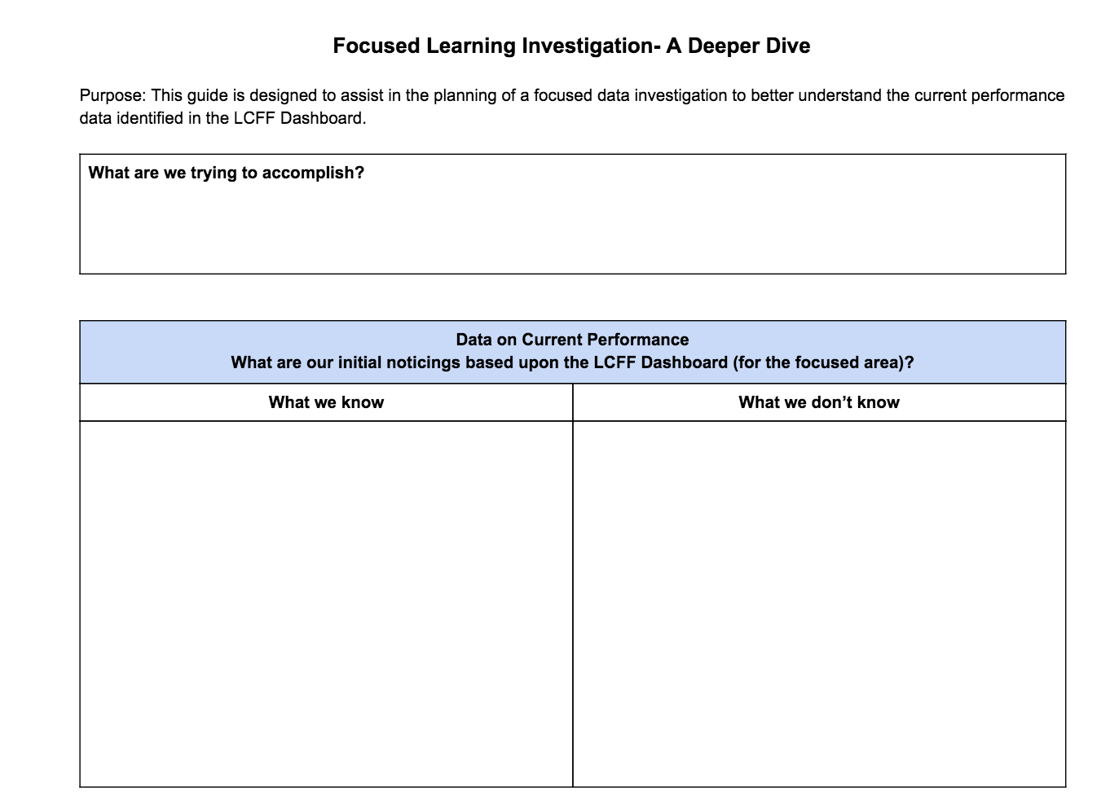
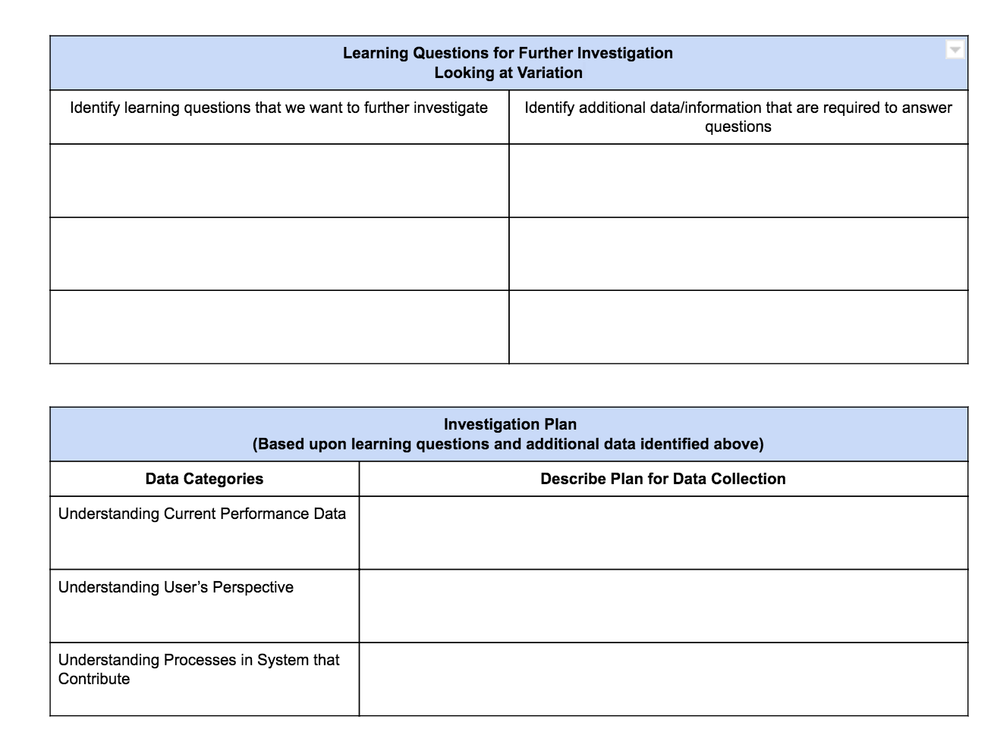
Example of a Planning Inquiry Tool-
Focused Investigation for Deeper Organizational Learning
Notes:
Slide Time: 3 min Running Time + 54 minutes
Presenter Notes:
Framing: We are providing this as a tool that can be used in supporting LEAs----this is not from the state---but a potential way to support districts in their inquiry.
Notice the use of the word “Focused”...this tool is designed to be used strategically for those areas that “we are curious about” and want to take a deeper dive to understand well why the system is getting the current results its getting---to then inform our improvement efforts through the LCAP.
Pause--- (2 minutes) ask participants to review planning tool and look at what they notice.
Share out--- then talk through each component--
Reflection Question (2 minutes): How might we help LEAs think about how and with whom to use inquiry to build understanding of a problem?
Teaching point: Key to engage stakeholders in this type of learning before getting to actions/services
https://docs.google.com/document/d/1viWjAoQY4GU_6na8pKI9WCL05GOD2bCFXxEUkpebcYs/edit?usp=sharing

Slide 25
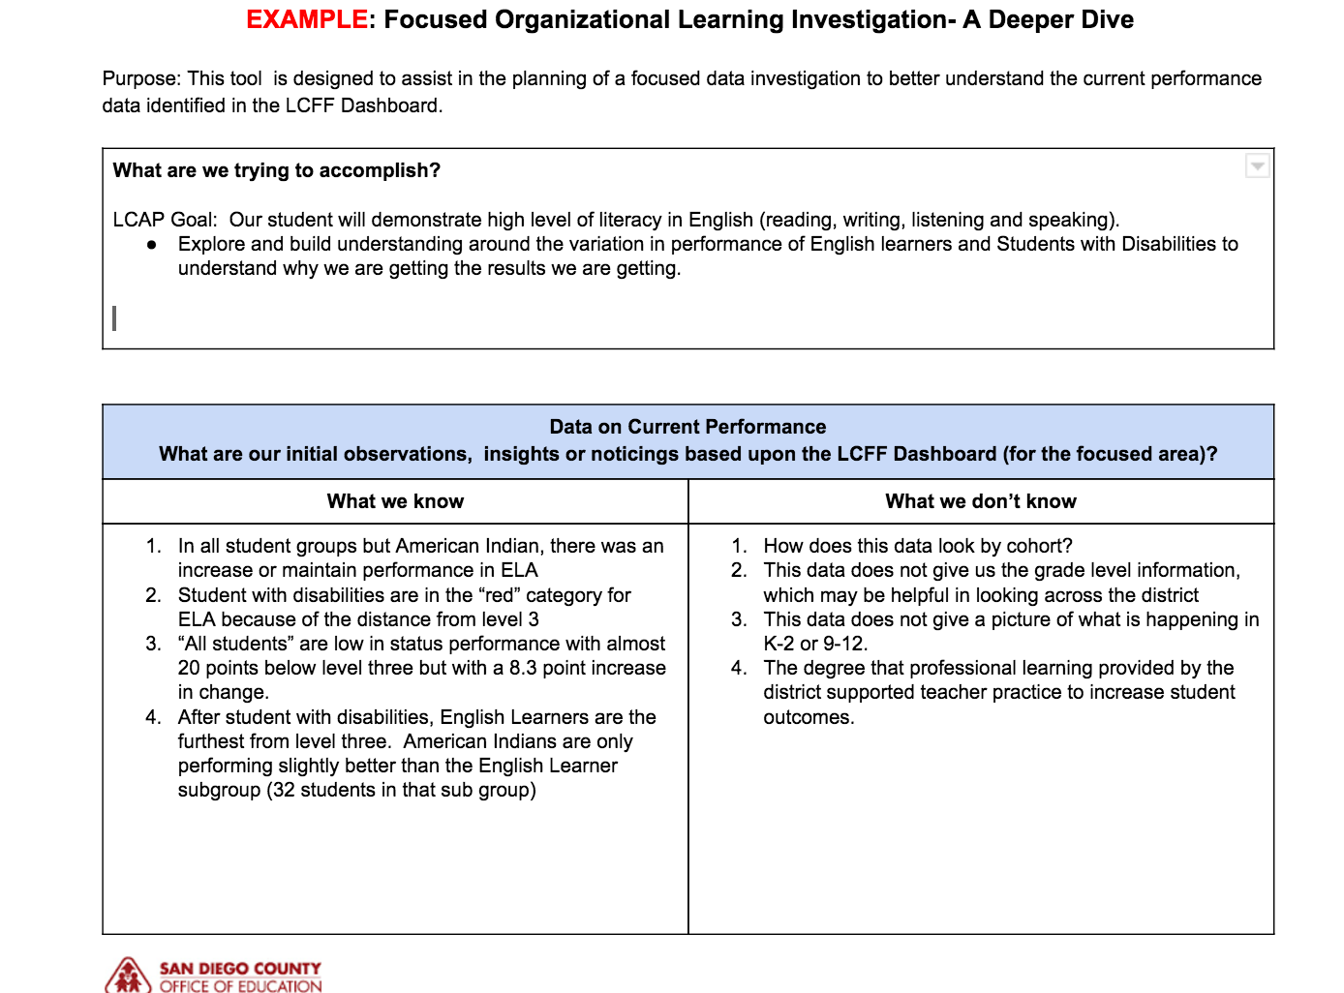
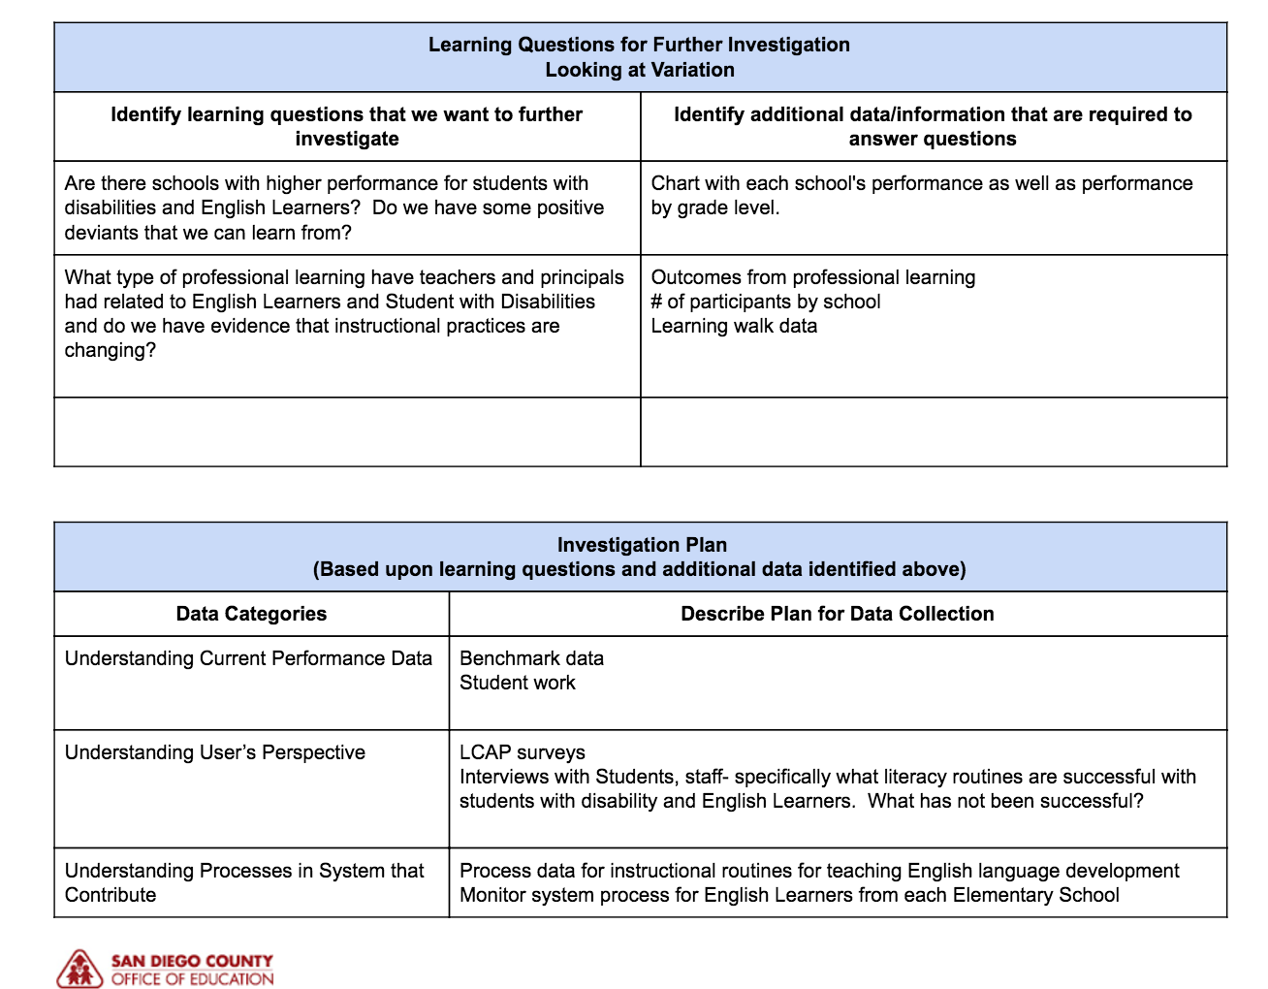
Example- Focused Investigation for Deeper Organizational Learning
Notes:
Slide Time: 4 min Running Time + 58 minutes
Presenter Notes:
Review sample based on selected district.
https://docs.google.com/document/d/1viWjAoQY4GU_6na8pKI9WCL05GOD2bCFXxEUkpebcYs/edit?usp=sharing

Slide 26
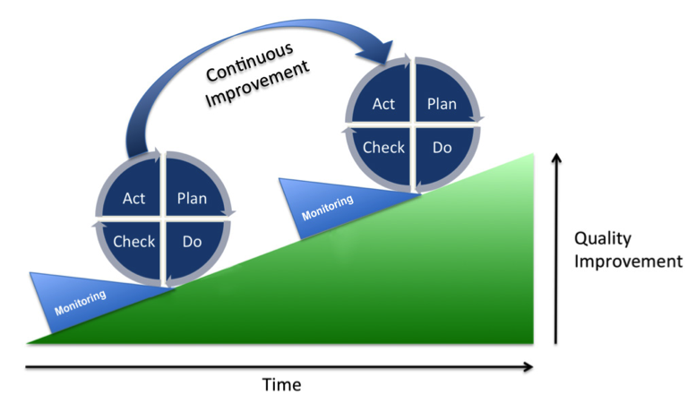
Final Thoughts- Continuous Improvement
Step-by-step incremental improvements based upon belief that continual improvement can occur by never-ending series of focused changes.
Notes:
Slide Time: 2 min Running Time + 77 minutes
Presenter Notes:
Reground in the idea that we are after Quality Improvement and the shift will be in supporting LEAs to shift to a LEARNING STANCE with their data to be able to go deep in figuring out why they are getting the current results before targeting improvement efforts around actions and services.
Key Take-Away: Supporting LEAs with processes to assist them in learning to build knowledge that leads to improvement

Slide 27
Communication:
Coherent Messaging &
Talking Points
CCSESA -February 2017
Notes:
Slide Time: 30 seconds Running Time +
Presenter Notes:
As we roll out the use of the California School Dashboard throughout our state and at each level of our system, we wanted to take the opportunity to process through the implications for Communication within each layer of our system.
For the purpose of this component of our learning, we will be primarily focusing on initial communication related to the purpose and utility of the California School Dashboard.

Slide 28
Provide County Office leaders with key considerations in designing a multi-layered communication plan related to the California School Dashboard
Suggest possible tools to be developed to support a multi-layered communication plan
Facilitate thinking around how the California School Dashboard might be used by various stakeholders (parents, teachers, and administrators) to focus efforts to address the needs of all students
Purpose
CCSESA - February 2017
Notes:
Slide Time: 30 seconds minute Running Time + 79 minutes
Presenter Notes:
Overview of the key purposes of this section.
In designing a multi-layered communication plan, it will be important to consider the various audiences (stakeholders) and what information may be most useful to them.
In this section, we provide some guiding questions to help leaders throughout the system think through their approach.

Slide 29

CCSESA - February 2017
Notes:
Slide Time: 1 minute Running Time + 80 minutes
Presenter Notes:
We are the architects of this messaging. This is an art form and is complex. We will be talking through how do we as a County Office leads preparing ourselves and plan accordingly to support our districts in messaging the new accountability model.
Each of us within our County offices have a tremendous amount of influence regarding how we create and deliver the message. While there is significant information regarding the architecture of the dashboard and the technical aspects of it, we are at the cusp of communication related to utilization of the dashboard.
Moving from technical navigation to utilization is where the art of communication comes in and where we can have tremendous impact.

Slide 30
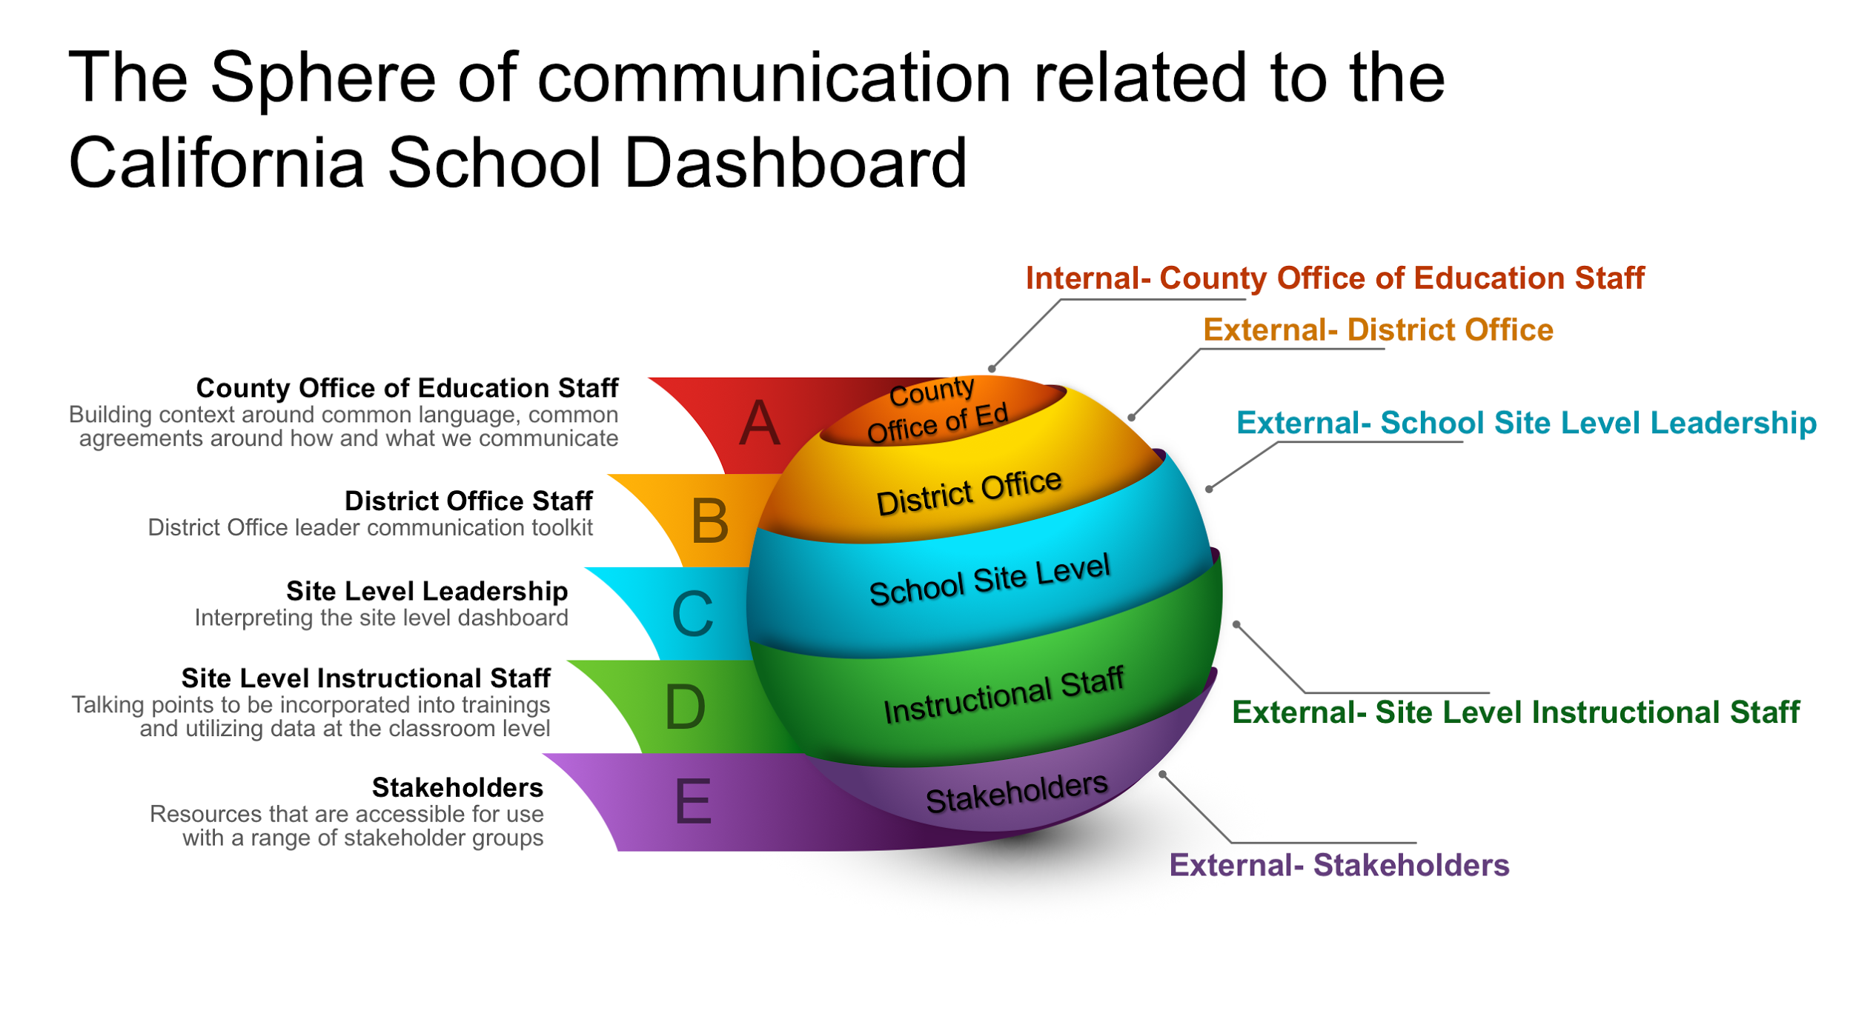
CCSESA - February 2017
Notes:
Slide Time: 2 minutes Running Time + 82 minutes
Presenter Notes:
CCSESA Talking points: We collectively represent more than 6.2 million students in the K-12 education system. The manner in which we communicate will have the potential to impact individuals in more than 1,000 districts and 1,200 charter schools across our state.
As the California School Dashboard information is beginning to populate it is important for us to remember that there are multiple dimensions of communication that will need to occur to support our entire state in adapting to this completely new approach to communicating student progress.
Briefly speak to this sphere of communication- no layer is more important and the order of the communication varies and occurs multiple times at multiple levels. We are presenting this solely for the purpose of utilizing a visual mode that we can process through.
COE to Districts: We collectively represent more than ______ students in the K-12 education system. The manner in which we communicate will have the potential to impact individuals in more than ____ districts and ____ charter schools across our state.
As the California School Dashboard information is beginning to populate it is important for us to remember that there are multiple dimensions of communication that will need to occur to support our entire state in adapting to this completely new approach to communicating student progress.
Briefly speak to this sphere of communication- no layer is more important and the order of the communication varies and occurs multiple times at multiple levels. We are presenting this solely for the purpose of utilizing a visual mode that we can process through.

Slide 31
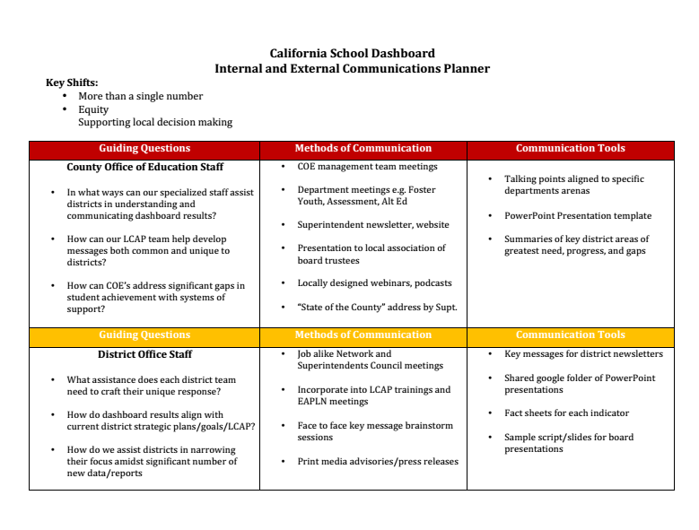
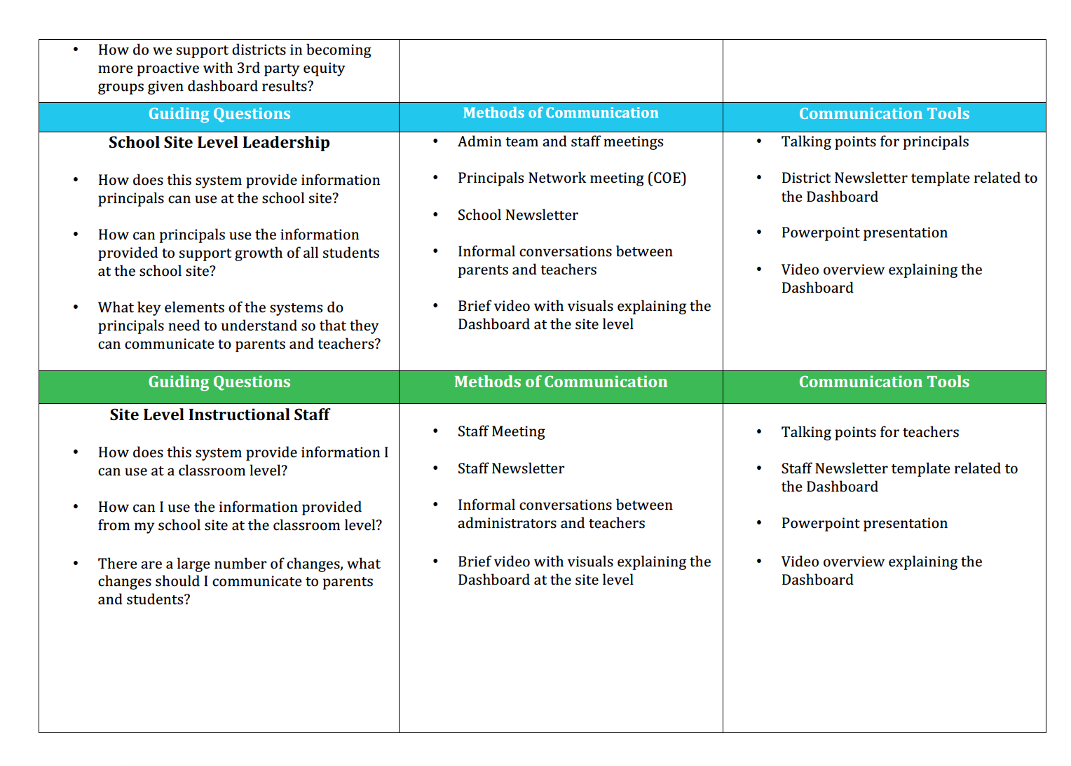
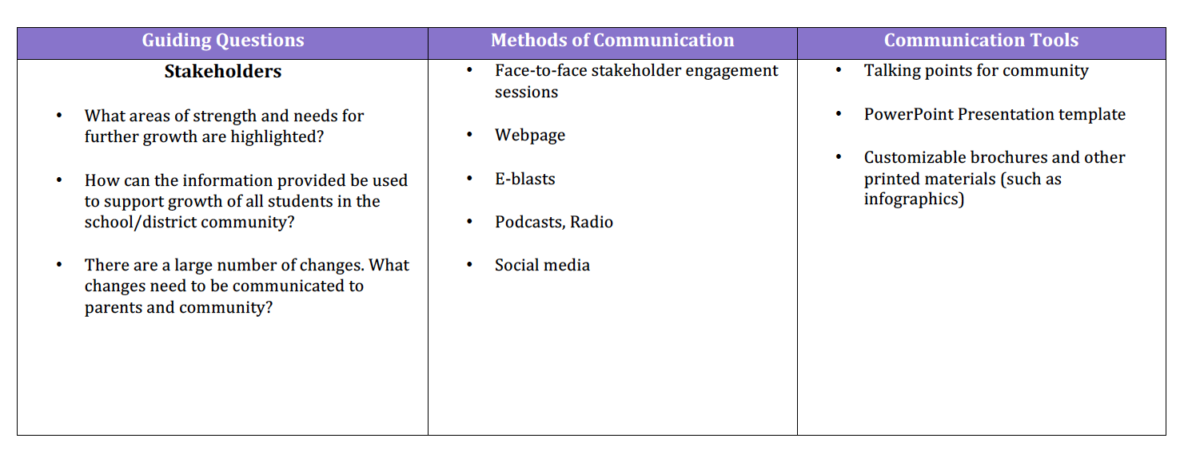
Key Shifts
for communication
Communications Planner
More than a single number | To help schools improve, the new accountability system reflects a quality education that is defined by more than a single test score.
Equity | The dashboard increases focus addressing disparities among student groups on any measure.
Supporting Local Decision-Making | The Dashboard will support the local strategic planning process; helping parents, educators and the public understand how schools and districts are performing on the concise set of measures that: Contribute to student success Identify strengths and weaknesses Highlight areas where improvement efforts should focus
Digital Handout
CCSESA - February 2017
Notes:
Slide Time: 3 minutes Running Time + 89 minutes
Presenter Notes:
The key to our success is building a collective common understanding of the California School Dashboard
Introduce the communication planner digital handout- provides guiding questions, methods of communication and tools to consider developing
Main talking points:
CDE has prepared three key shifts for communication related to the Dashboard
Review each theme, read through the components.
More than a single number emphasizes the importance of being mindful of this being a multiple measures system. Moving to a number of different data sources to provide a more well rounded perspective of status and growth.
Equity- This emphasizes the importance of making every student visible. By looking at each system from a multiple measures system and looking at a variety of different student groups we are able to see where there are bright spots as well as performance gaps providing us the opportunity to address equity and opportunity gaps.
Supporting Local decision making- The California School Dashboard and the introduction of the LCFF Evaluation Rubrics and indicators is intentionally designed to support ongoing local decision making. This key shift is important for us to be mindful of as we are engaging in messaging with all stakeholders as this is a
Significant shift in thinking from the previous state accountability structure.
In the subsequent section of this element, we have tried to collect our best thinking for our district partners in thinking through communications implications for each layer of the system related to these key shifts.

Slide 32
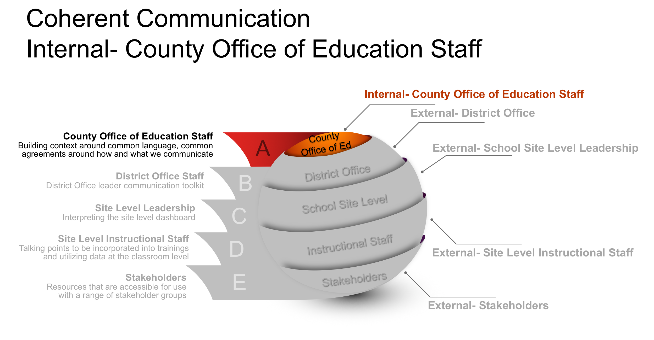
Notes:
Slide Time: 1 minute Running Time + 90 minutes
Presenter Notes:
CCSESA Talking Points:
Communication considerations when planning for Internal communication with County Office of Education
Varying knowledge among COE department leaders related to rubrics, LCAP changes, district data, entire accountability system
Ongoing and new opportunities to assist districts in areas of need, strength, and achievement gaps
Expectation on the part of districts that ALL COE leaders are technical experts in this new accountability system
COE Talking Points when working with district partners:
As a County Office Staff we are being very thoughtful and intentional in our messaging internally to ensure that our supports and services to our district partners maintain consistent messaging. We understand the importance of our trainings and assistance being anchored into the same three key shifts.
We are working within our internal structures to ensure that we are all prepared to be the best possible support for our district partners in implementing this transformational accountability structure.
**Note** This is an informational slide that may be used with district partners but is not essential to the messaging.

Slide 33
Coherent Communication
Internal- County Office of Education Staff
Key Shifts | Guiding Questions | Methods of Communication | Communication Tools
More than a single number Equity Supporting local decision making | In what ways can our specialized staff assist districts in understanding and communicating dashboard results? How can our LCAP team help develop messages both common and unique to districts? How can COE’s address significant gaps in student achievement with systems of support? | COE management team meetings Department meetings e.g. Foster Youth, Assessment, Alt Ed Superintendent newsletter, website Presentation to local association of board trustees Locally designed webinars, podcasts “State of the County” address by Supt. | Talking points aligned to specific departments arenas PowerPoint Presentation template Summaries of key district areas of greatest need, progress, and gaps
Notes:
Slide Time: 2 minutes Running Time + 92 minutes
Presenter Notes:
Primary focus developing a shared understanding among internal County Office staff. In addition to the methods of communication listed, consider planning differentiated training for:
County superintendent, Alt Ed leaders, C/I and LCAP teams, Foster Youth and EL
Advocates, parent educators, trustees, PIO

Slide 34
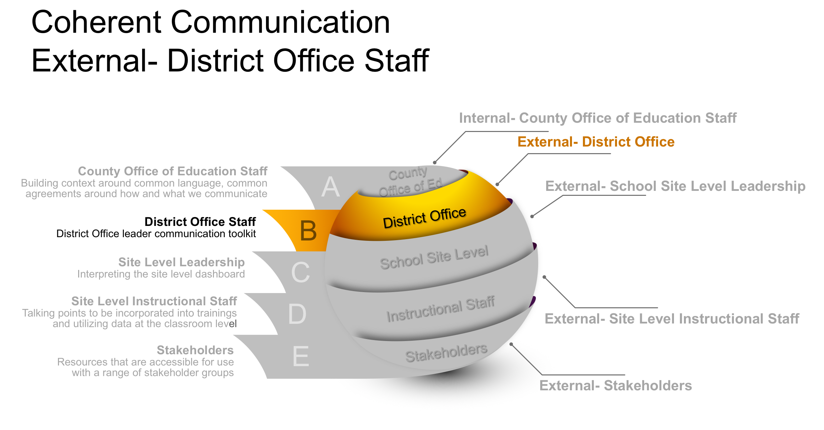
Notes:
Slide Time: 1 minutes Running Time + 93 minutes
Presenter Notes:
Communication considerations when planning for external communication with district office staff
Providing high level brief messages that can be incorporated into district office messages.
Anticipate district leaders asking for communication tools (slides with scripts) that can be easily adapted to multiple audiences
Possible interest in COE developing media advisory in anticipation of March public launch
As we collected our best thinking around each of the remaining layers of the sphere of communication, we looked from the perspective of the leadership in charge of delivering the key messages. As we move forward you will see guiding questions, methods of communication and potential tools to develop and utilize at each layer of the sphere of communication.

Slide 35
Coherent Communication
External- District Office Staff
Key Shifts | Guiding Questions | Methods of Communication | Communication Tools
More than a single number Equity Supporting local decision making | What assistance does each district team need to craft their unique response? How do dashboard results align with current district strategic plans/goals/LCAP? How do we assist districts in narrowing their focus amidst significant number of new data/reports How do we support districts in becoming more proactive with 3rd party equity groups given dashboard results? | Job alike Network and Supts Council meetings Incorporate into LCAP trainings and EAPLN meetings Face to face key message brainstorm sessions Print media advisories/press releases | Key messages for district newsletters Shared google folder of powerpoint presentations Fact sheets for each indicator Sample script/slides for board presentations
Notes:
Slide Time: 2 minutes Running Time + 94 minutes
Presenter Notes:
In addition to internal communications, COEs also need to consider communication methods and tools for external messaging to districts and the broader community. Some of the key considerations include support for districts:
To develop their own communication strategies with their communities.
To analyze and use their data to align goals and actions.
To develop proactive communications for stakeholder groups.

Slide 36
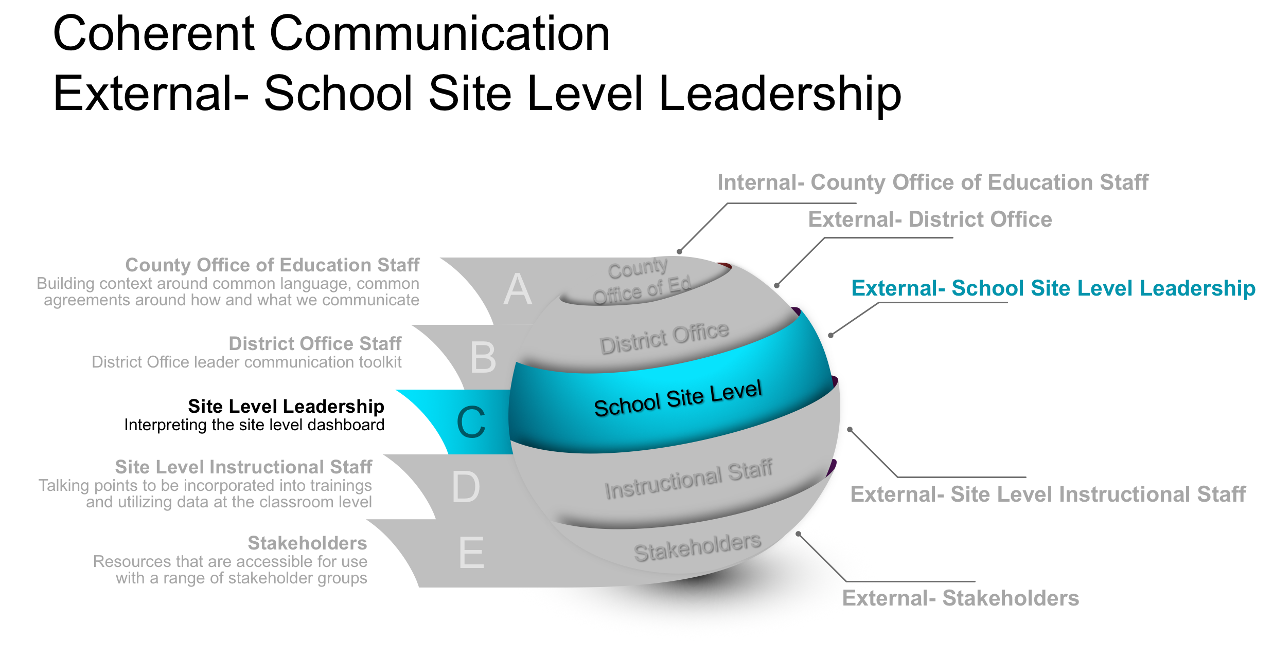
Notes:
Slide Time: 1 minutes Running Time + 95 minutes
Presenter Notes:
Communication considerations when planning for external communication with school site leadership -- information that helps stakeholders at the school site level understand purpose of accountability system (the why?) and how this information might be used to focus efforts to support students.
We may want to include some potential resources for site leaders, or a list of items that could be developed templates for newsletters, presentations, website and social media.
Maybe include a fact sheet for communication pointers for working with school site leaders

Slide 37
Coherent Communication
External- School Site Level Leadership
Key Shifts | Guiding Questions | Methods of Communication | Communication Tools
More than a single number Equity Supporting local decision making | How does this system provide information principals can use at the school site? How can principals use the information provided to support growth of all students at the school site? What key elements of the systems do principals need to understand so that they can communicate to parents and teachers? | Admin team and staff meetings Principals Network meeting (COE) School Newsletter Informal conversations between parents and teachers Brief video with visuals explaining the Dashboard at the site level | Talking points for principals District Newsletter template related to the Dashboard Powerpoint presentation Video overview explaining the Dashboard
Notes:
Slide Time: 2 minutes Running Time + 97 minutes
Presenter Notes:
Principals are situated within districts and their school communities. When thinking through ways that COEs can provide support for site leadership, some key considerations might be:
Supporting site principals in developing an understanding of the information provided through the Dashboard (through district admin team or County Office Principal Networks, etc.)
Providing site leaders with tools for communicating with their stakeholders (teachers, parents, community members)
Supporting site leaders to be able to use the information provided through the Dashboard to support teaching and learning at their site.
Consider communication through County Office Principal networks- do we as a county office interact directly with site level leadership
Methods of communication from the county office to site level leadership
Methods of communication for site leaders to utilize at their site with teachers and parents.

Slide 38
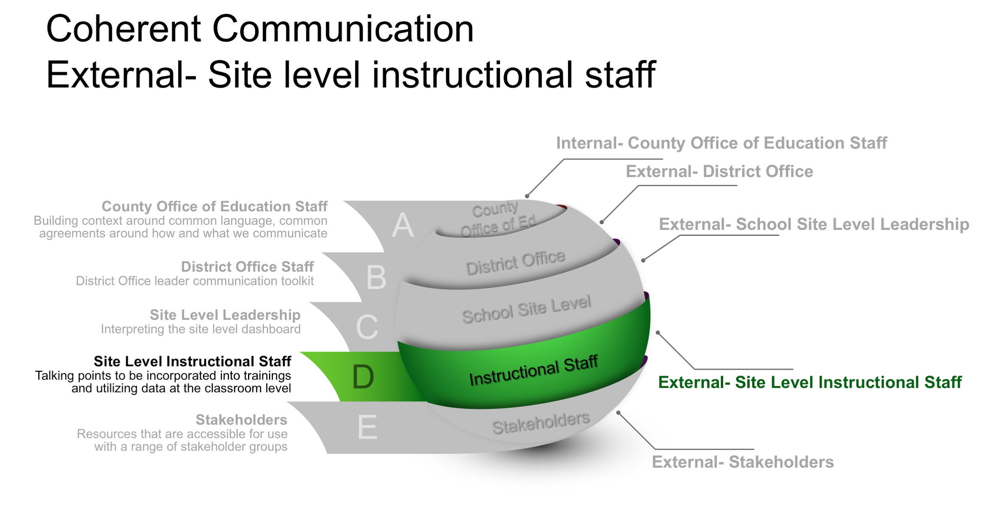
Notes:
Slide Time: 1 minute Running Time + 98 minutes
Presenter Notes:
Communication considerations when planning for external communication with site level instructional leadership. Being mindful of the impact of this on site leadership and site instructional staff is important.
As we communicate out how the Dashboard functions and is to be utilized, our messaging to teachers from a leadership perspective is going to be essential. Balancing providing the appropriate information without creating
Information overload will be essential.

Slide 39
Coherent Communication
External- Site level instructional staff
Key Shifts | Guiding Questions | Methods of Communication | Communication Tools
More than a single number Equity Supporting local decision making | How does this system provide information I can use at a classroom level? How can I use the information provided from my school site at the classroom level? There are a large number of changes, what change should I communicate to parents and students? | Staff Meeting Staff Newsletter Informal conversations between administrators and teachers Brief video with visuals explaining the Dashboard at the site level | Talking points for teachers Staff Newsletter template related to the Dashboard Powerpoint presentation Video overview explaining the Dashboard
Notes:
Slide Time: 1 minutes Running Time + 99 minutes
Presenter Notes:
Considerations for leaders as they plan to work with their instructional staff. Considering the development of communication pieces for teachers.
Anchored around the three key shifts that we will be communicating, considering the development of templates for district and site leaders to utilize with their teachers around the introduction of the Dashboard’s.

Slide 40
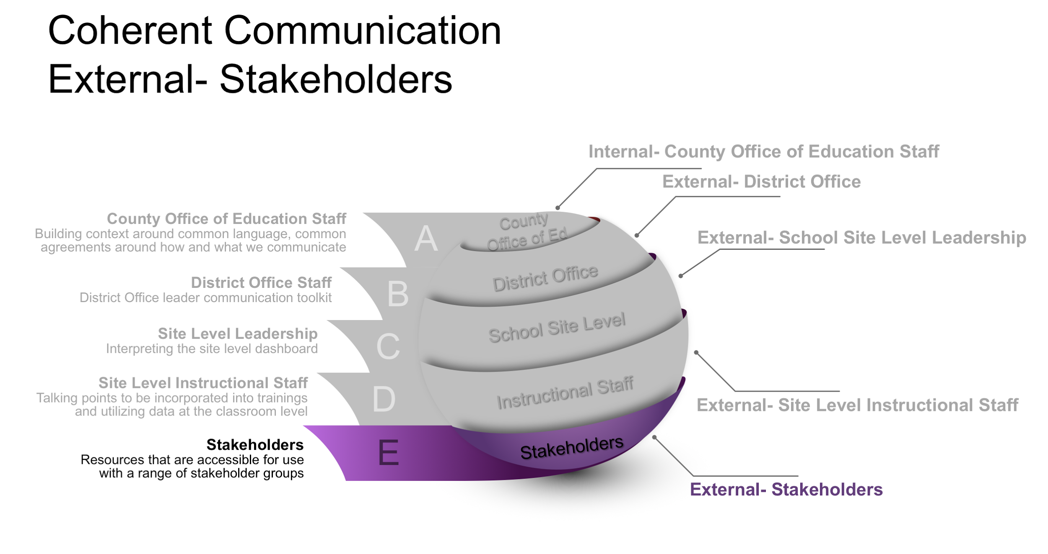
Notes:
Slide Time: 1 minute Running Time + 100 minutes
Presenter Notes:
As we consider stakeholder groups for communication, this layer has multiple components. When planning for communication in this domain keep in mind that communication will need to occur with individuals such as:
Board Members
Community Organizations
Parents and Students
Communication considerations when planning for external communication with stakeholders:
Various utility of each of the four displays within Dashboard
How deep into the technical features of the various 5 x 5 grids do they need to go?

Slide 41
Coherent Communication
External- Stakeholders
Key Shifts | Guiding Questions | Methods of Communication | Communication Tools
More than a single number Equity Supporting local decision making | What areas of strength and needs for further growth are highlighted? How can the information provided be used to support growth of all students in the school/district community? There are a large number of changes. What changes need to be communicated to parents and community? | Face-to-face stakeholder engagement sessions Webpage E-blasts Podcasts, Radio Social media | Talking points for community PowerPoint Presentation template Customizable brochures and other printed materials (such as infographics)
Notes:
Slide Time: 1 minute Running Time + 101 minutes
Presenter Notes:
Considerations for leaders as they plan to work with stakeholders -- community, governing board, parents. Considering the development of communication pieces for various audiences.
Anchored around the three key themes that we will be communicating, considering the development of templates for district and site leaders to communicate with a broader audience around the introduction of the Dashboard.
Multiple platforms of communication to extend reach.
It is important to consider what level of detail needs to be communicated.

